Slide 1









Doctor Appointment System

Slide 2
PRESENTED BY:
Kazi Mashun Ahmed
ID: 193002112
Al Mamon
ID: 193002160
Department of CSE
Green University of Bangladesh
SUPERVISED BY:
Mr. Mozdaher Abdul Quader
Lecturer
Department of CSE
Green University of Bangladesh

Slide 3










CONTENTS
Introduction
Objectives
Problem Statement
Related Work
Requirements
Proposed Solutions
Implementations and Tools
Evaluation Matrix
Conclusion
Reference

Slide 4





INTRODUCTION
The actual waiting times in Canada were 47 to 229 minutes.
61% of the patients waited 90 to 180 minutes in the outpatient department in the USA.

Slide 5




OBJECTIVES
To ease the doctor’s appointment system.
To reduce the wasting time for patients.
To make sure the online payment of the doctor’s fees.
To provide a digital patient record system.
To provide easy & fast ambulance service.
To provide an easy & fast blood donation service.

Slide 6
Problem Statement
Patients have to wait a long period even sometimes they can’t meet with the doctor.
In emergency situations managing blood and ambulance, people face problems.
Manual payment and patient records take more time.

Slide 7
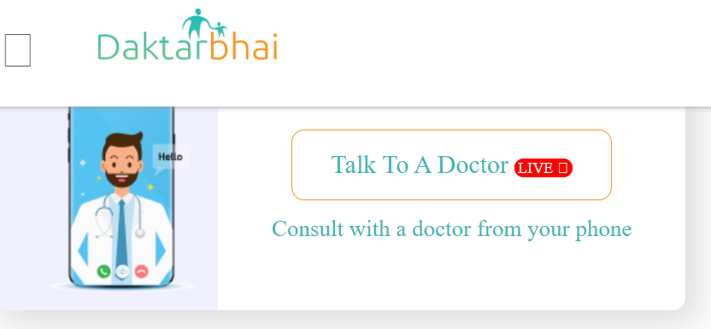
RELATED WORKS
daktarbhai.com
Working Process | Drawbacks
Appointment service | Time-consuming
Health packages | High price service
Elderly care service | Can’t show the appointment time
Video call to a doctor

Slide 8
RELATED WORKS (CONT.)
doctorsbd.com
Working Process | Drawbacks
Provide Doctors list | Not provide an appointment system
Provide hospital’s location | Can’t show the appointment time

Slide 9
Functional and Nonfunctional requirements
Software system requirements are often classified as:
a) Functional Requirements:
These are statements of services the system should provide, how the system should react to particular input and how the system should behave in particular situations.
⮚ The user will be able to search the information about patient, Doctor, and all detail.
⮚ The system will provide appropriate report for the user expectation.

Slide 10
Functional and Nonfunctional requirements(CONT.)
Non functional Requirements:
These are including timing constraint, constraint on the development process and standards. Non functional Requirements often apply to the system as a whole It is less acceptable failure rate.
It has more privacy and safety also.
It is less acceptable failure rate.

Slide 11
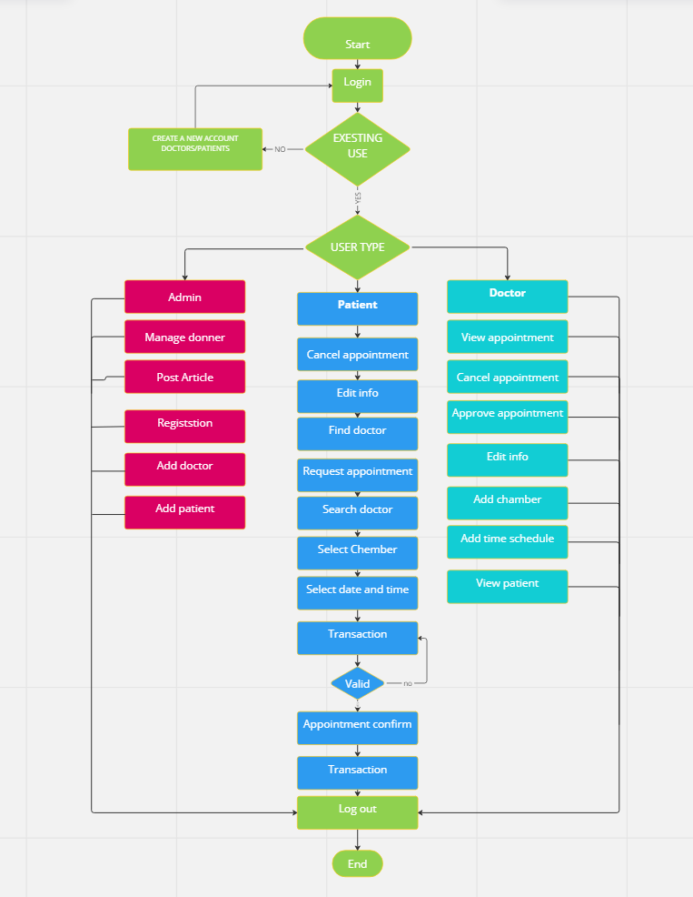
Flow Chart

Slide 12
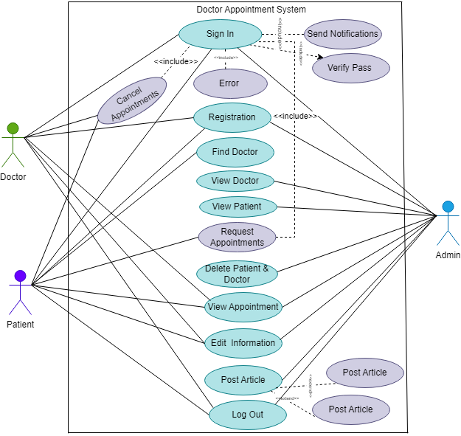
Use Case Diagram

Slide 13
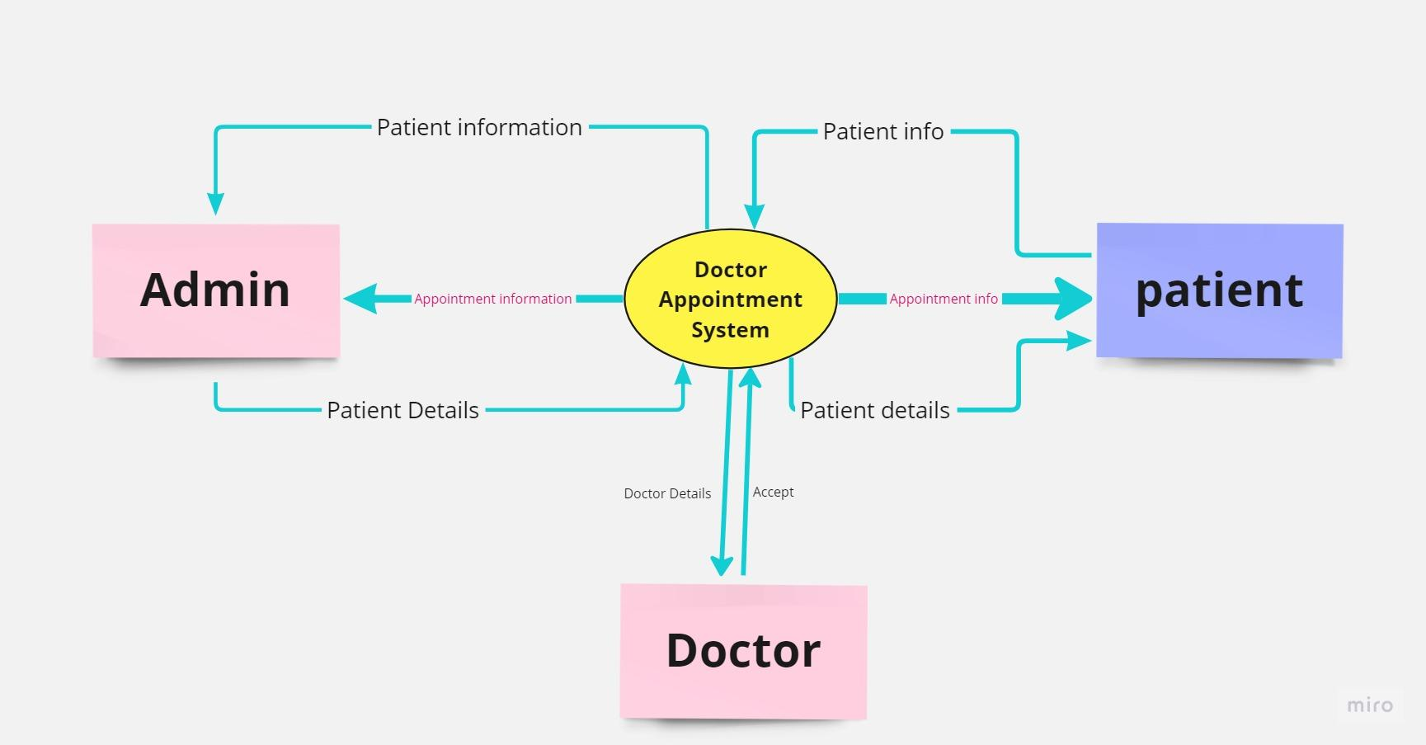
DFD Level 0

Slide 14
TOOLS AND TECHNIQUE
Front End :
Html , css ,JavaScript,Bootstrap.
Backend:
Php
Data base :
Mysql
Text Editor :
Visual Studio code.

Slide 15
Implementation
The implementation of a system can take place to determine the success of the system. Implementation stages of a system provide user confidence. This procedure has been designed so that most problems can be managed.

Slide 16

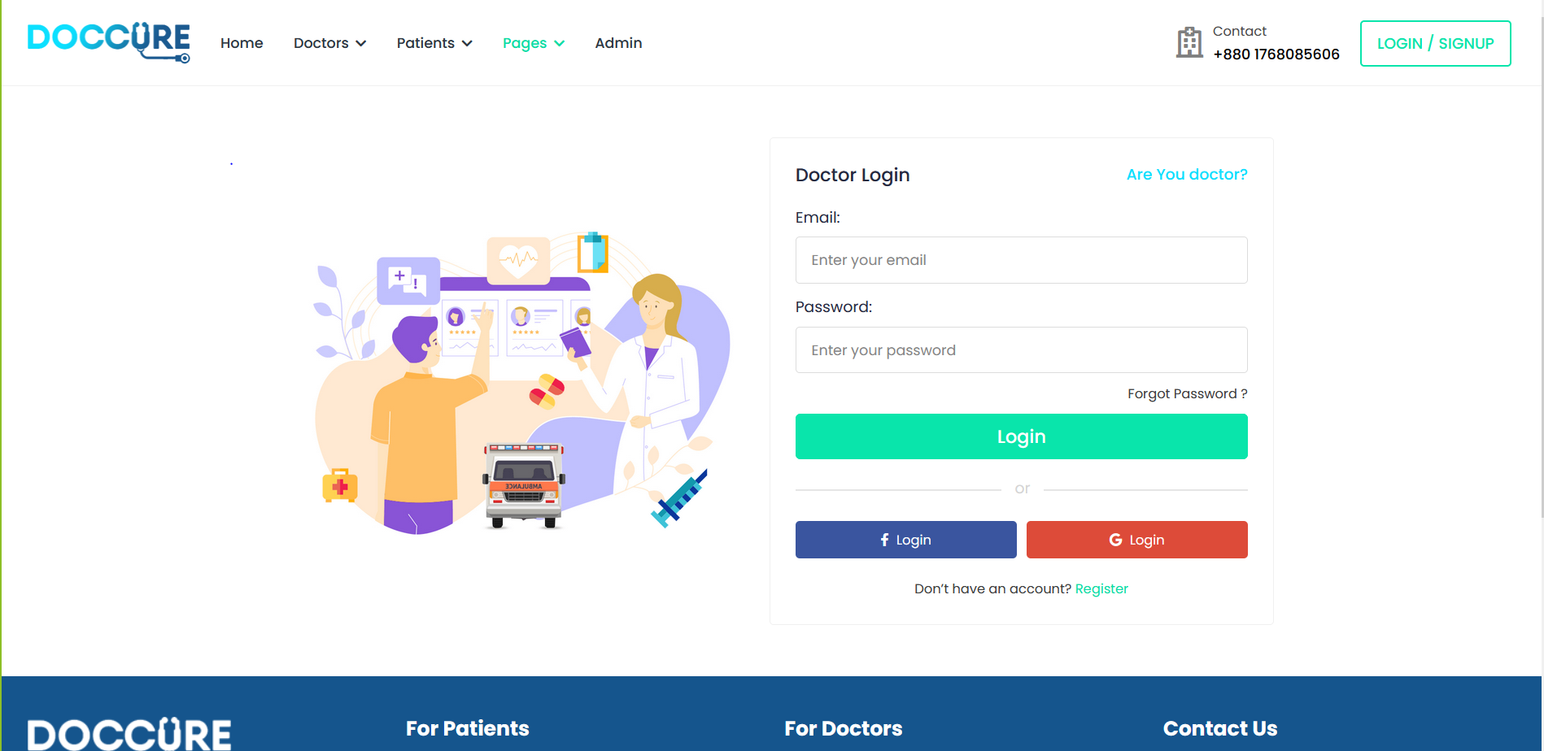
Implementations

Slide 17
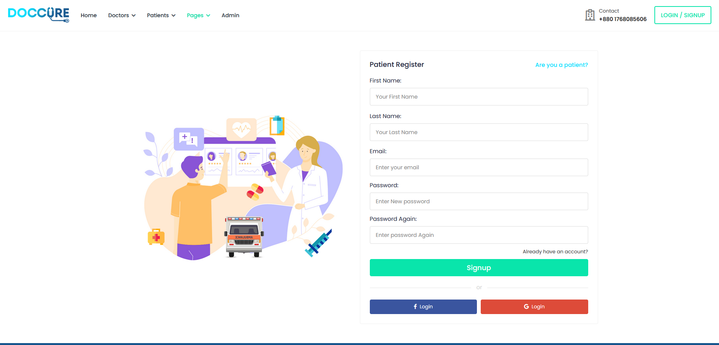
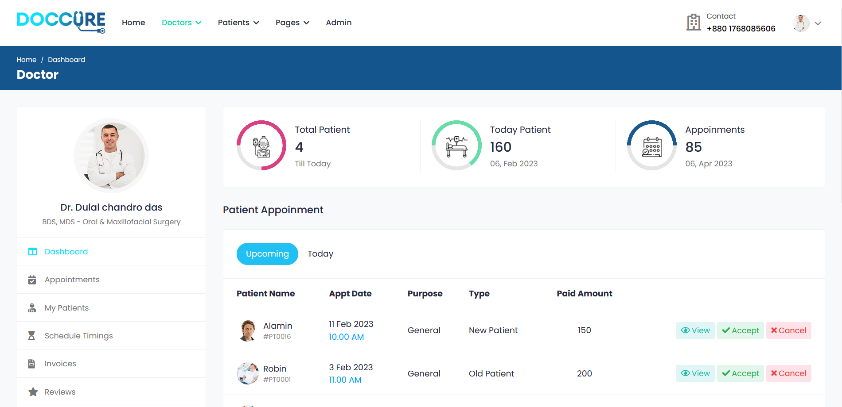
Implementations(Cont.)

Slide 18
CONCLUSION
Creating a time-saving appointment system.
Users can find multiple emergency services.
Doctors can confirm or decline appointments.
Patients can know the exact time of their appointment.
Creating a digital payment and patient record system.

Slide 19
REFERENCES
[1] Xie, Z. and Or, C. (2017) “Associations between waiting times, service times, and patient satisfaction in an Endocrinology Outpatient Department: A time study and questionnaire survey,” INQUIRY: The Journal of Health Care Organization, Provision, and Financing, 54, p. 004695801773952. Available at: https://doi.org/10.1177/0046958017739527.
[2] WHO, W. (2017) Bangladesh is still to meet the demand of safe blood supply, World Health Organization. World Health Organization. Available at: https://www.who.int/bangladesh/news/detail/14-06-2017-bangladesh-is-still-to-meet-the-demand-of-safe-blood-supply.
[3] Daktarbhai, D. (2017) Daktarbhai, Your Health, Take Care. Available at: https://www.daktarbhai.com/.

